Slide 1
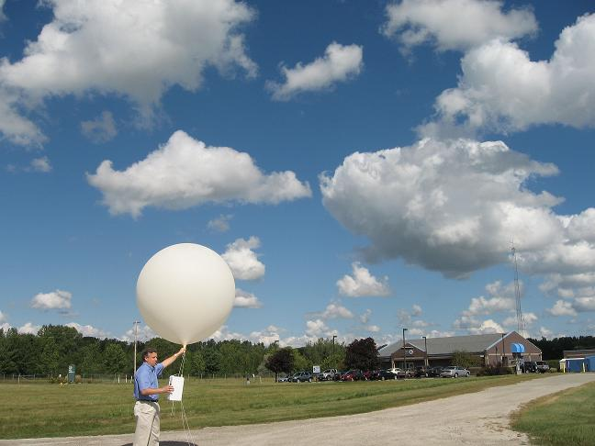
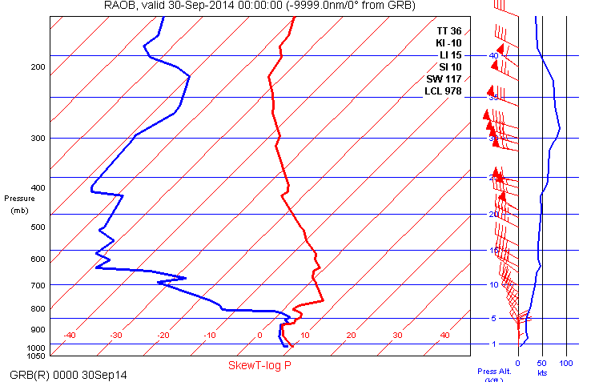
Upper Air Soundings
How to understand and use radiosonde and forecast soundings
Richard Mamrosh – NWS GRB

Slide 2
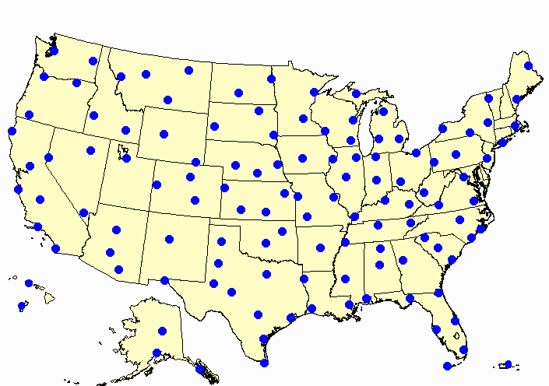
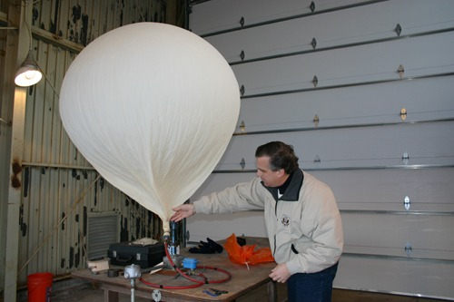
The Basics
Weather balloons measure temperature, air pressure, relative humidity, and wind as they ascend to around 100,000 feet.
They are launched at 1100 and 2300 UTC at around 70 locations in the United States.
The data are used by forecasters in National Weather Service offices and in Numerical Weather Prediction models.

Slide 3
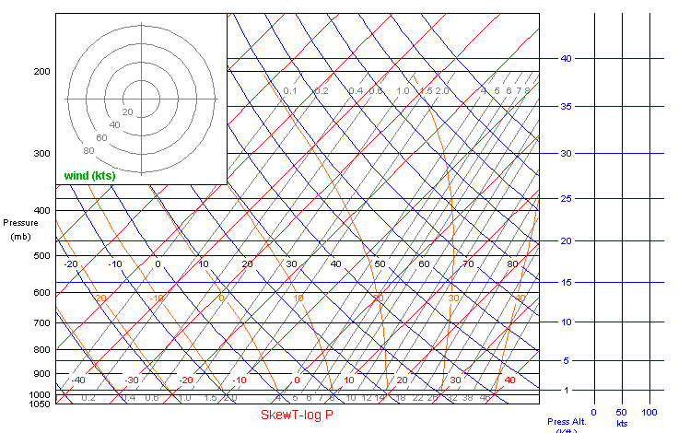
Skew – T Plots
Winds
are
plotted
here
Temperature (C) – red slanted lines
Dry Adiabats – blue lines Winds are plotted
Moist Adiabats – orange lines on scale to the right
Mixing Ratio – gray lines
Remember – data are plotted to pressure altitude, not to height AGL!!!

Slide 4
Upper Air Data – Soundings
Upper air data from stations can be displayed as a sounding (or skew-t) plot. They display temperature, dewpoint, and wind speed and direction.

Slide 5
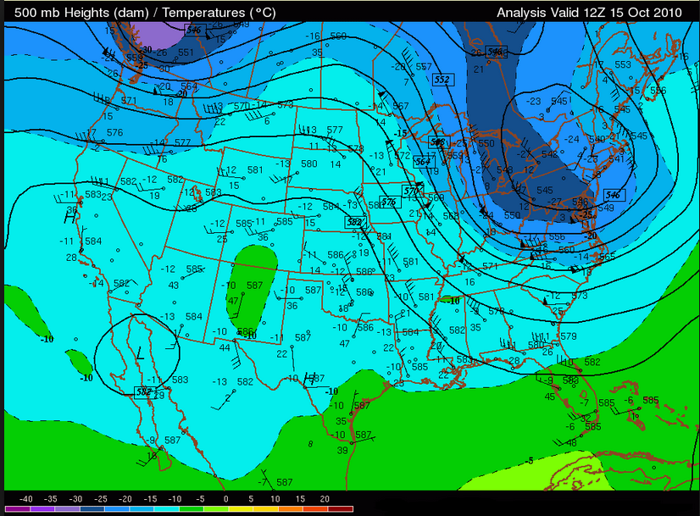
Upper Air Data – Standard Level Plots
Upper air data from many stations can be plotted on maps at standard pressure
levels and analyzed to show features such as jets and fronts.

Slide 6
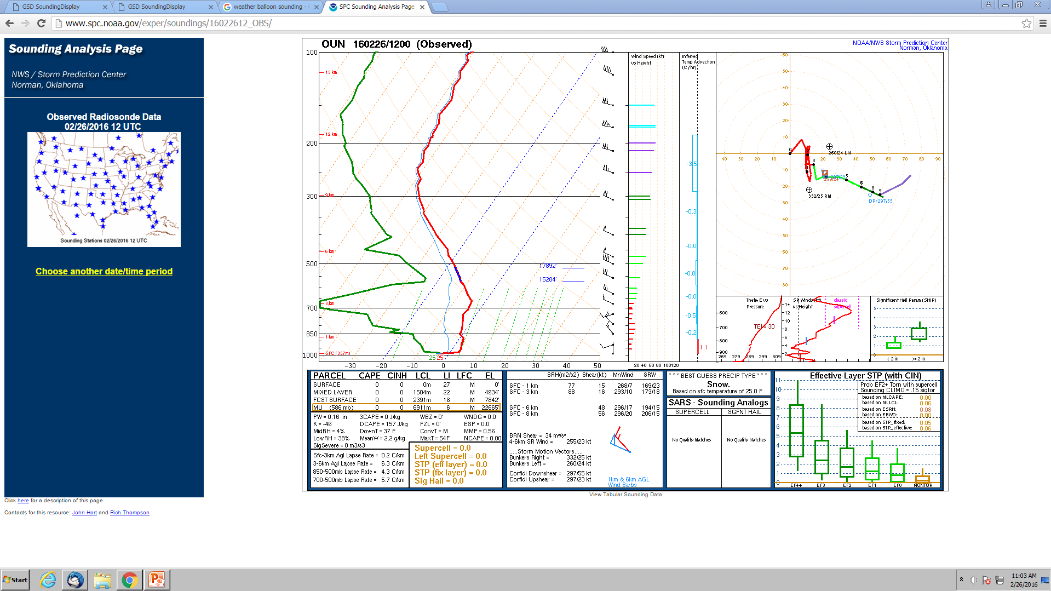
Where to Find Soundings
Soundings just from radiosondes can be found at http://www.spc.noaa.gov/exper/soundings/

Slide 7
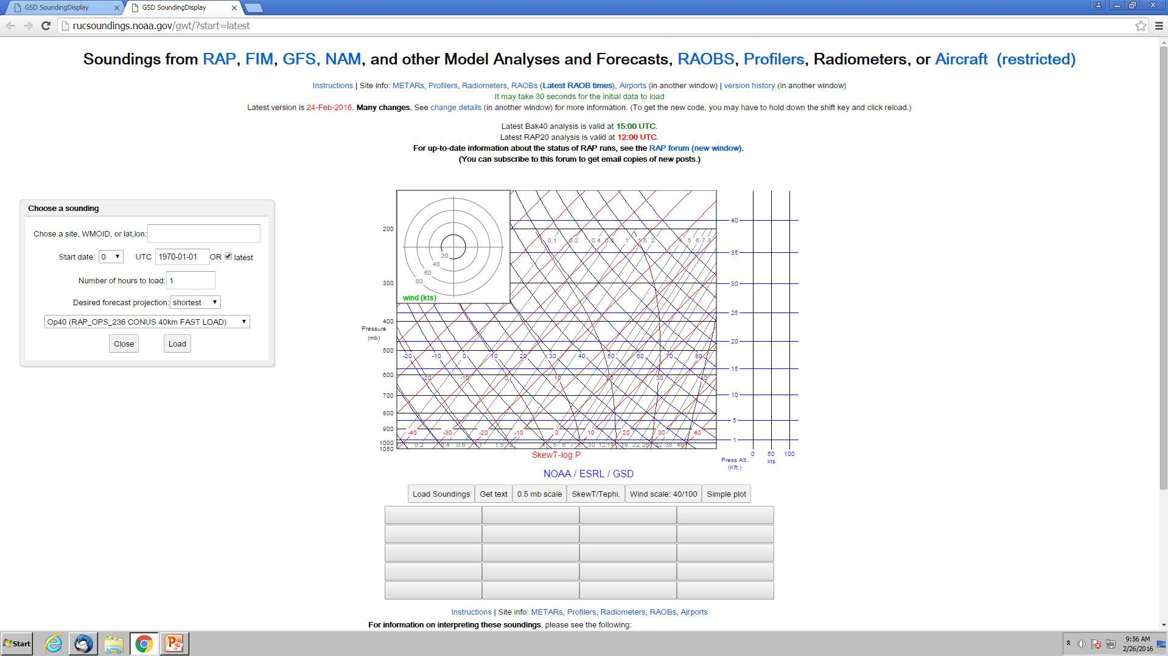
Where to Find Soundings
Radiosonde and Forecast soundings can be found at http://rucsoundings.noaa.gov/gwt/?start=latest
We will look at some soundings from this web site.

Slide 8
The web page will
start with a blank
sounding background.

Slide 9
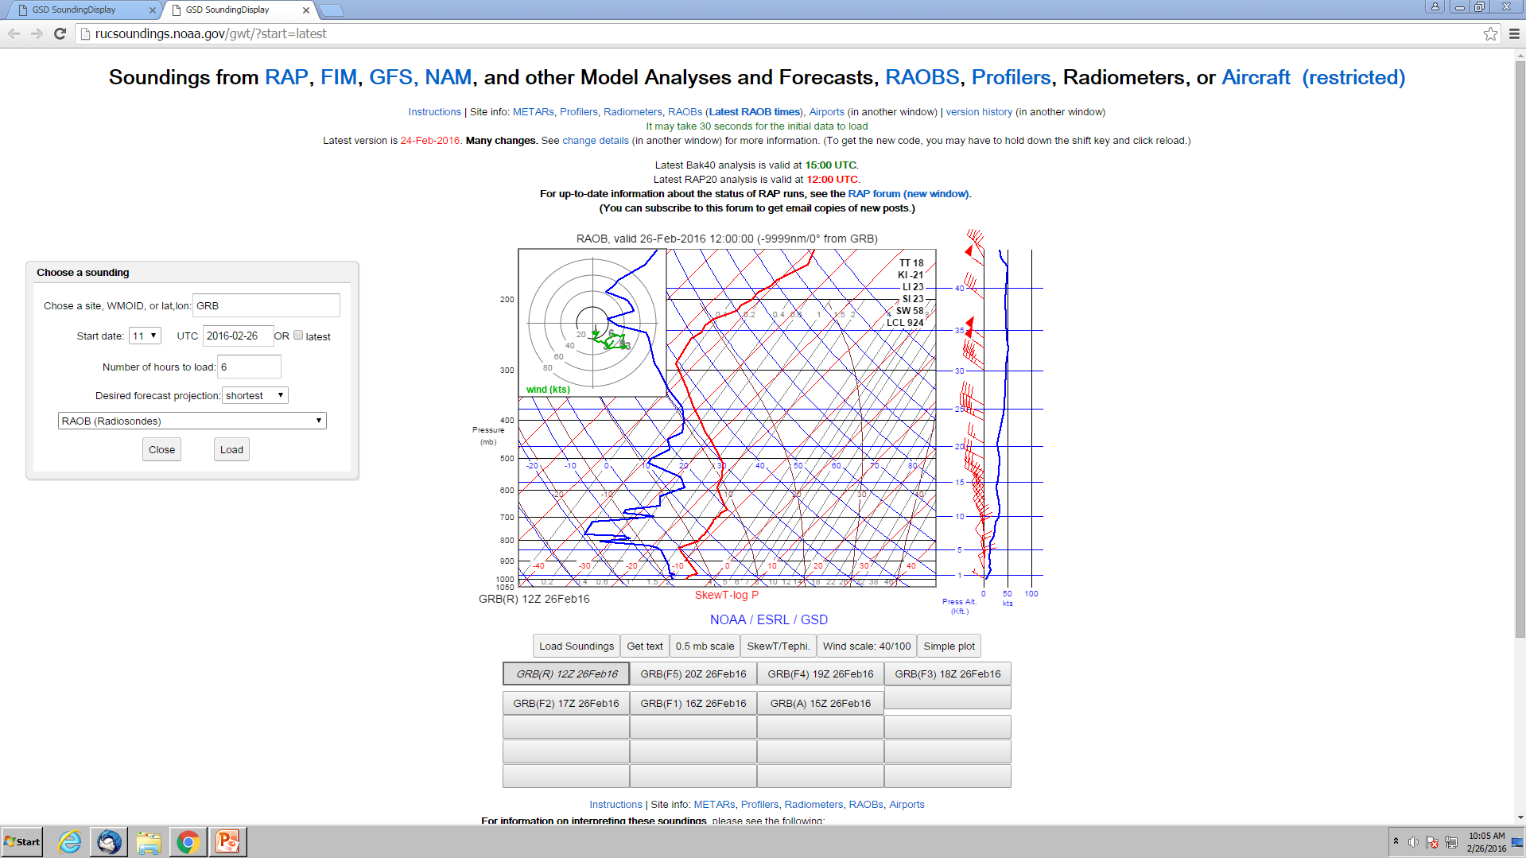
If you want to see a
radiosonde sounding,
type in an upper air
location, select 11z or
23z as the start time,
and choose RAOB from
the menu.
Radiosonde locations
nearby include DVN,
MPX, INL, ILX, DTX, APX

Slide 10
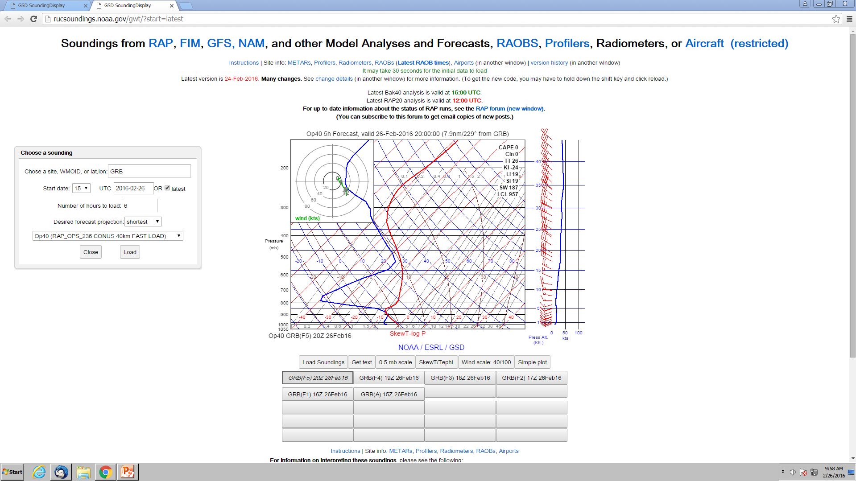
If you want to see a
forecast sounding,
type in an airport,
select the current or
a future time, the
number of forecast
hours, and the
forecast model.

Slide 11
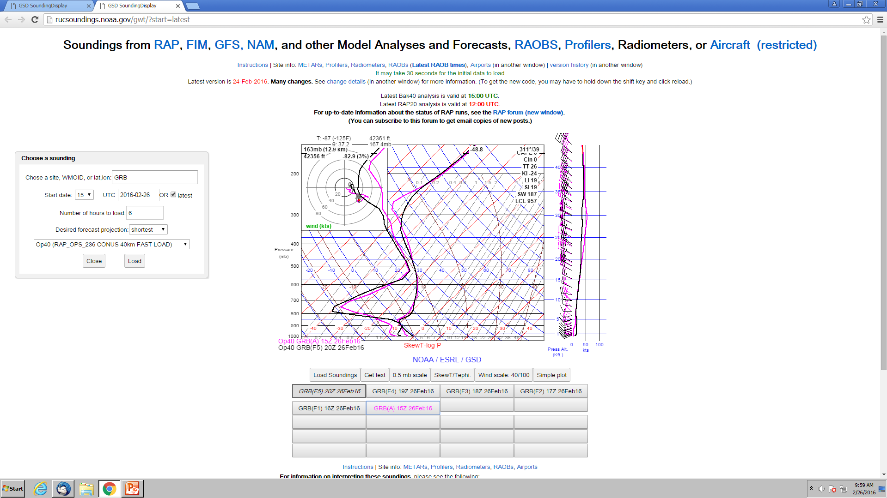
If you would like to
superimpose two
or more soundings,
hold down the
shift key and click
on the gray tabs
at the bottom.

Slide 12
How Can We Use Soundings?
Real time or forecast soundings can be useful in flight planning, and possibly during flight.
Soundings can help a pilot determine where there might be clouds, precipitation, icing potential, and turbulence.

Slide 13
Sky Cover
Real time and forecast soundings can be useful to determine where clouds might be.
Radiosondes have difficulty measuring 100% relative humidity at cold temperatures.
Clouds are not always present at 100 % measured relative humidity.
Virga may be present below saturated layers.
Forecast soundings are not perfect.

Slide 14
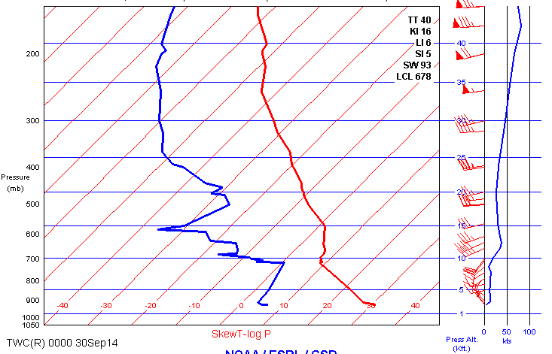
Desert Type Sounding
9,700’
Tuscon, Arizona
Station Elevation
2643 Feet
METAR KTUS 292253Z 27012KT 10SM CLR 32/03 A2987

Slide 15
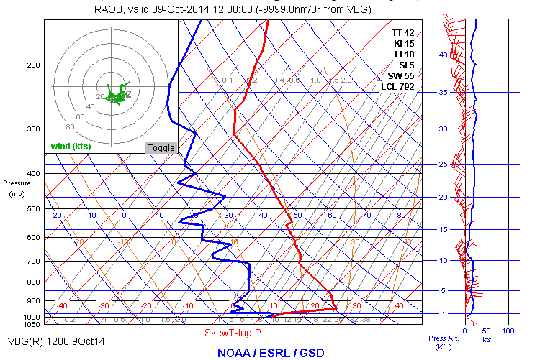
Fog at ground, clear above
492’
Vandenburg AFB
Station Elevation
368 Feet
KVBG 091055Z AUTO 00000KT 1/4SM FG VV001 13/13 A2990

Slide 16
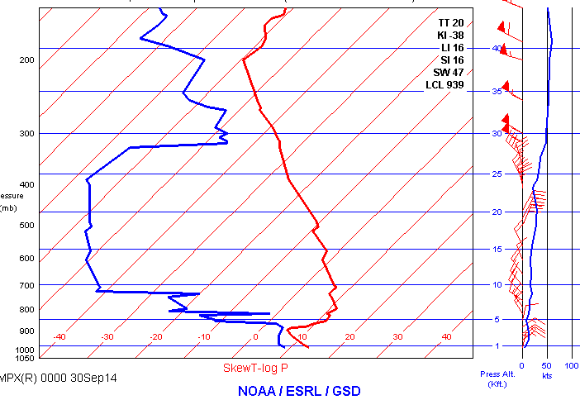
Shallow Low Level Moisture
Remember that
the levels depicted
in soundings are
pressure altitude,
and you need to
subtract airport
elevation to achieve
approximate
height AGL.
3,400’
Minneapolis, MN
Station Elevation
842 Feet
METAR KMSP 292255Z 06011KT 10SM BKN025 13/07 A3011

Slide 17
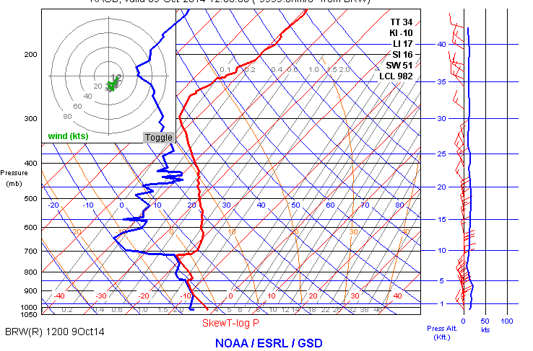
Cloudy and Light Snow
2,467’
Barrow, Alaska
Station Elevation
49 Feet
METAR PABR 091153Z 35015KT 9SM –SN OVC026 M02/M06 A3003

Slide 18
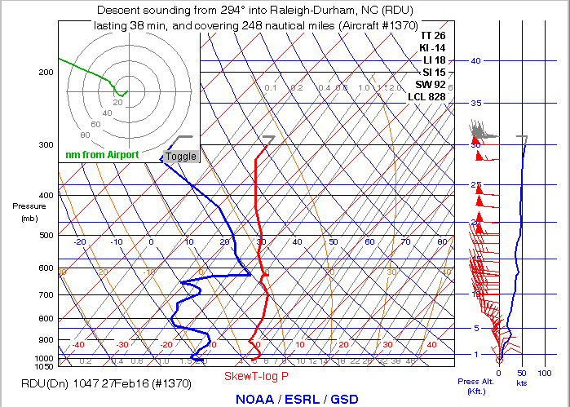
A Few Middle Clouds
Quiz?
12,740’
Raleigh Durham
Station Elevation
435 Feet
KRDU 271151Z 00000KT 10SM FEW120 M04/M08 A3023

Slide 19
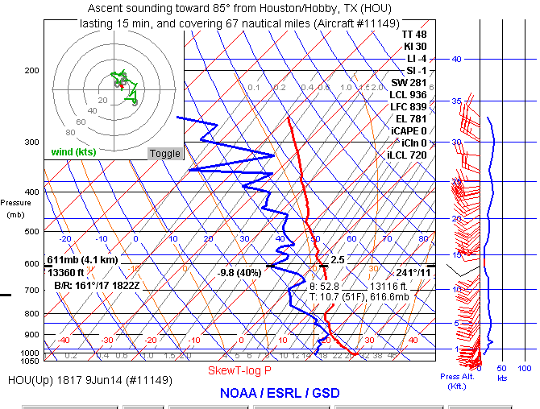
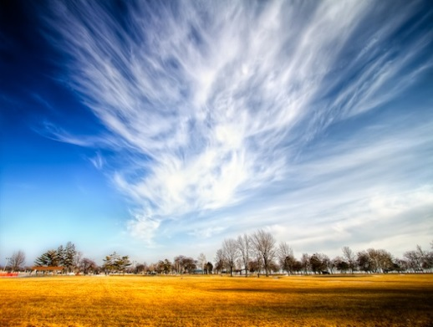
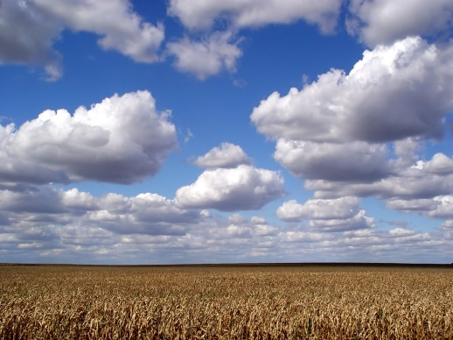
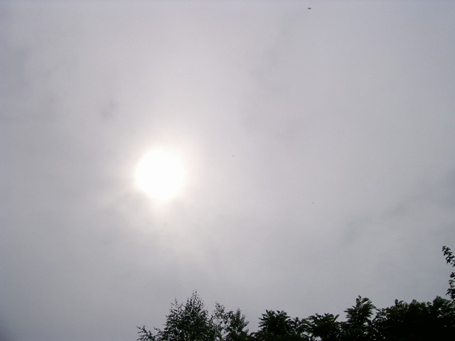
Sky Quiz
Low level moisture - cumulus

Slide 20
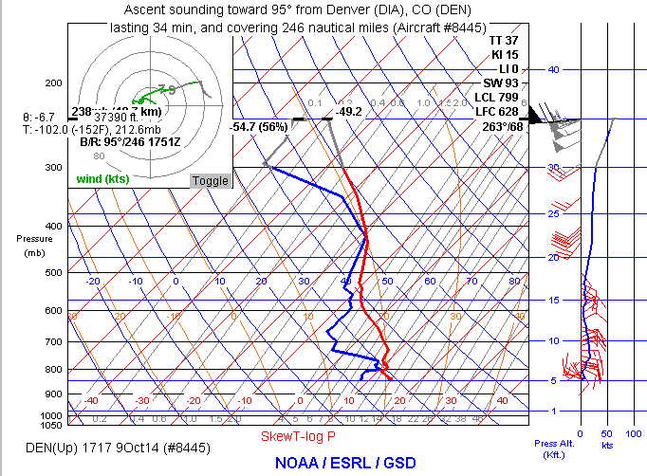
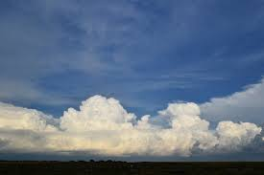
Sky Quiz
Low and upper level moisture –
cumulus and cirrus

Slide 21
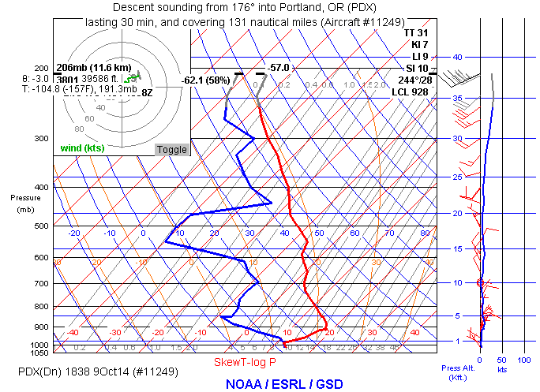
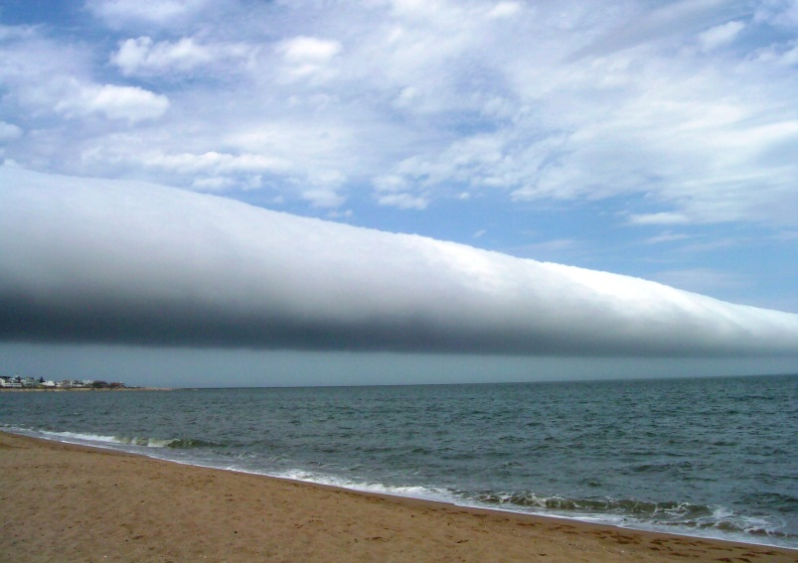
Sky Quiz
shallow low level moisture – stratus

Slide 22
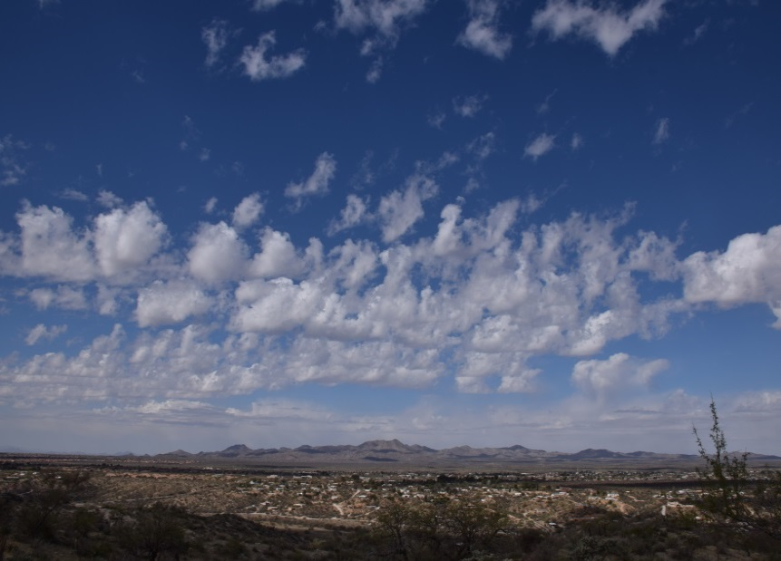
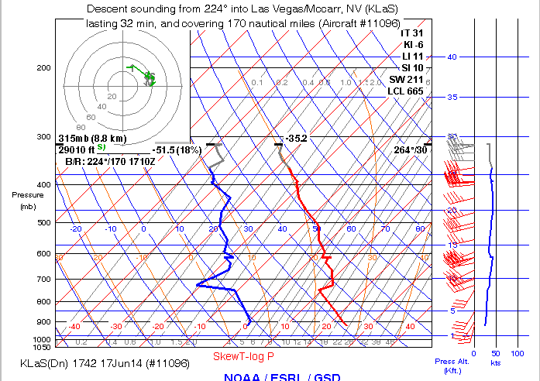
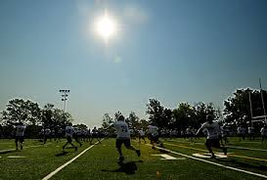
Sky Quiz
Very dry air – sunny skies

Slide 23
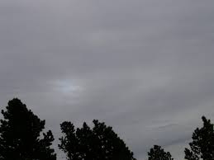
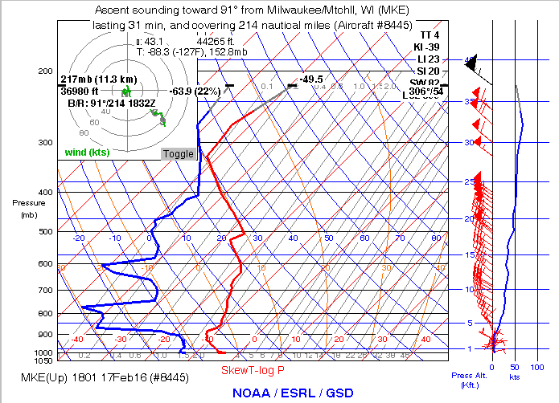
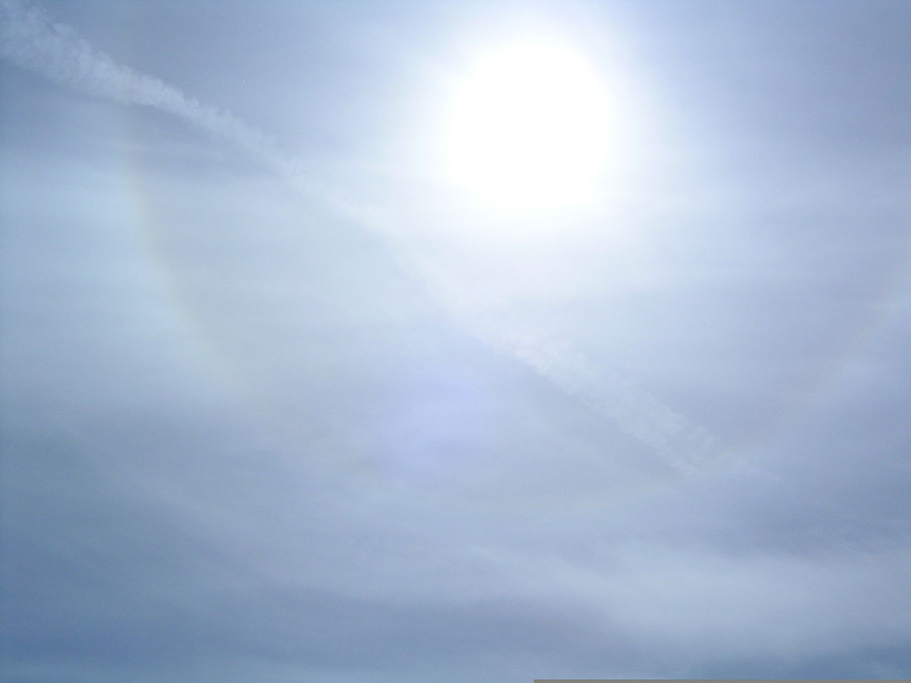
Sky Quiz
High thin moisture – ice crystals

Slide 24
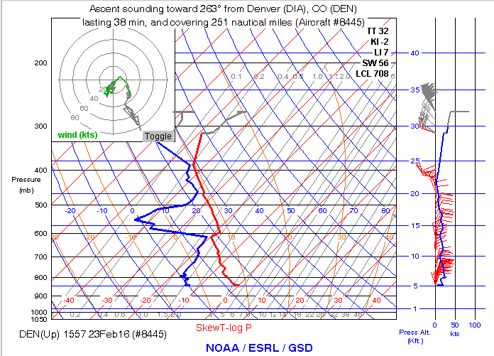
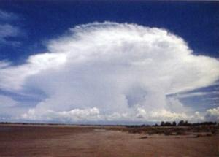
Sky Quiz
Flying between cloud layers

Slide 25
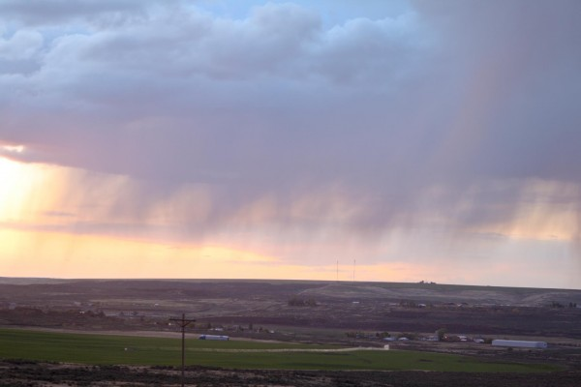
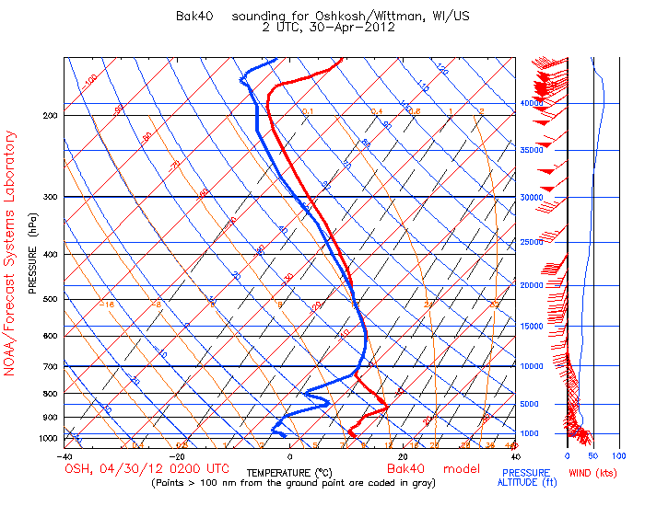
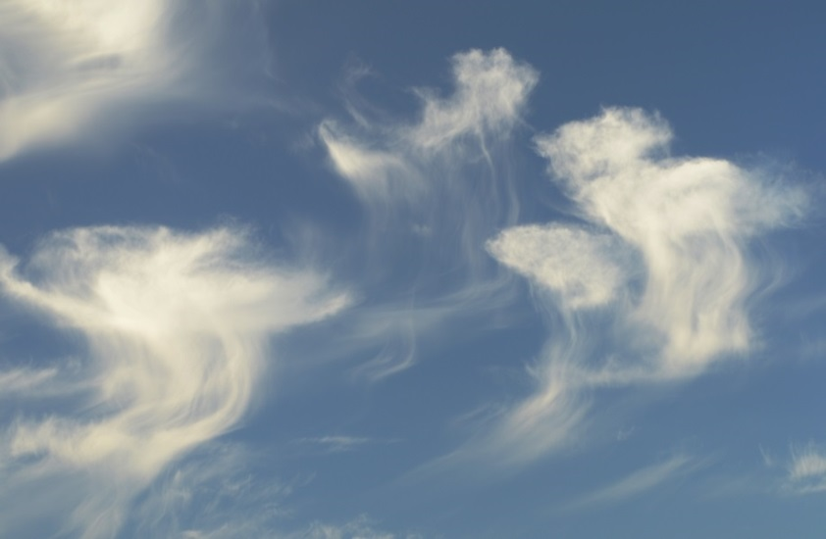
Sky Quiz
Virga falling from middle clouds
Next Precipitation Type

Slide 26
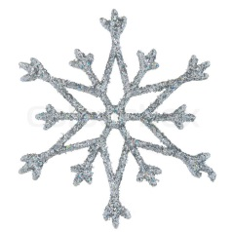
Precipitation Type
Soundings can help a pilot determine what kind of precipitation might occur by showing
The freezing level
Presence of warm layers aloft
Depth of cold air near the ground
Probability of ice crystals
Amount of moisture

Slide 27
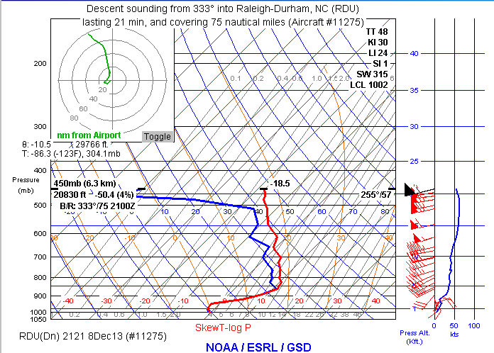
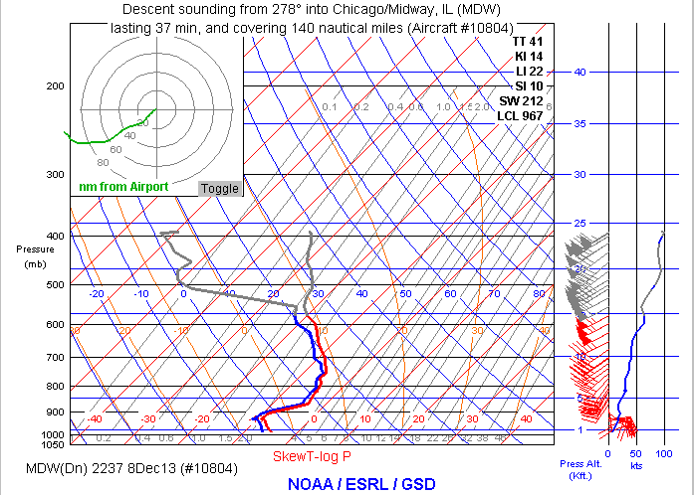
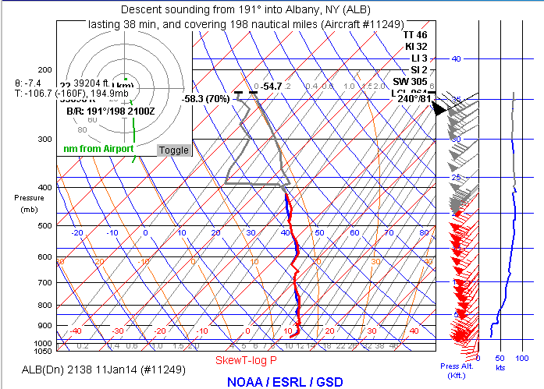
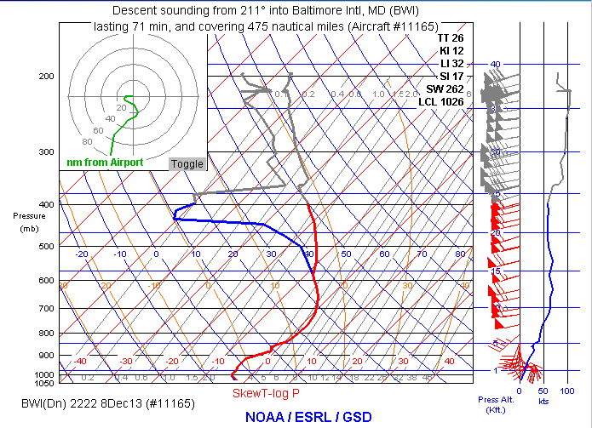
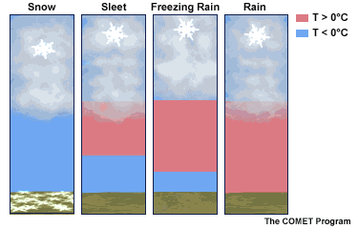
Precipitation Type of Winter Storms
Soundings are very useful, as knowledge of the temperature structure in the lowest 5,000’ is necessary to successfully forecast precipitation type.
Notes:
This animation shows environments that produce different types of precipitation, and aircraft sounding examples of each.

Slide 28
Precipitation Type Quiz
Temperatures usually must be -10c or colder in order to get snow (provided it does not melt on it’s way down). Need Ice Crystals.
Moisture less than a few thousand feet deep usually produces drizzle or freezing drizzle.
Snow can usually fall about 1,000’ through an above freezing environment before melting.

Slide 29
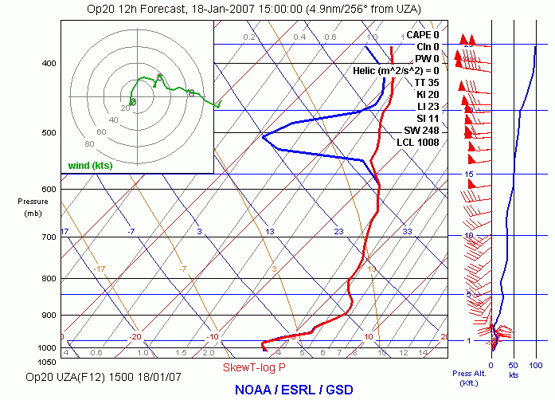
Snow, Rain, Freezing Rain, Sleet?
Answer: Not cold enough for snow, cold air too shallow for sleet, too
cold at surface for rain, so freezing rain likely.

Slide 30
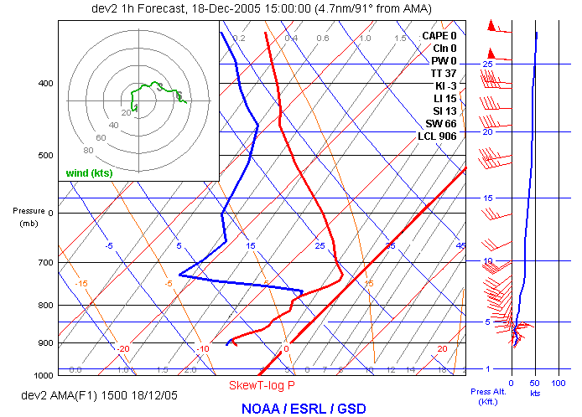
Snow, Sleet or Freezing Drizzle?
Answer: Not cold enough for snow, no elevated warm layer for sleet, so freezing drizzle likely.

Slide 31
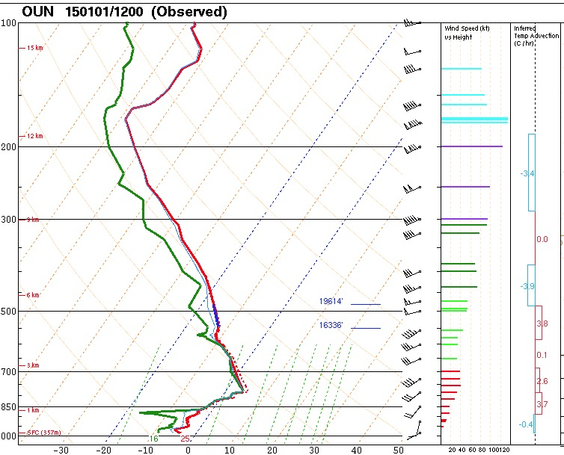
Snow, Rain, Freezing Rain, Sleet?
Answer: Cold enough aloft for snow, but it would melt on the way down. Melted snow should freeze in cold air near the ground, so sleet is likely.

Slide 32
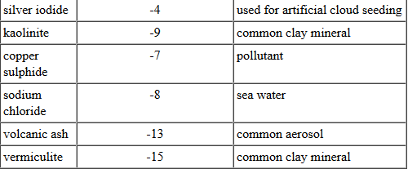
Icing Possibilities
Soundings can be useful to determine where icing environments may be present.
Temperatures between -15C and 0C are usually most conducive to significant icing. The amount of icing partly depends on the lack or presence of ice forming nuclei, such as
When temperatures are less than -20c there are primarily ice crystals, instead of supercooled water vapor.

Slide 33
Icing Possibilities

Slide 34
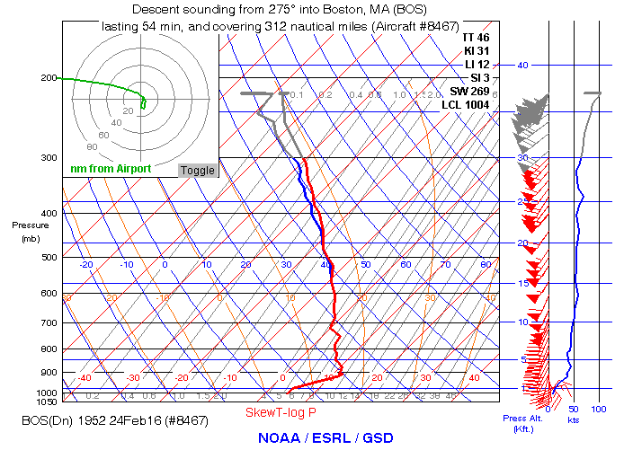
Icing Possibilities
15-20,000’
10-15,000’
5-10,000’
Sfc -5,000’

Slide 35
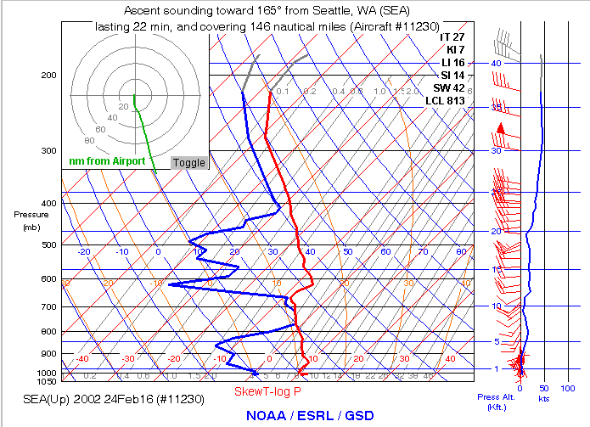
Icing Quiz
Where is the
greatest icing
potential?
No icing
above 20k ft
above 7k ft
7-10 k ft

Slide 36
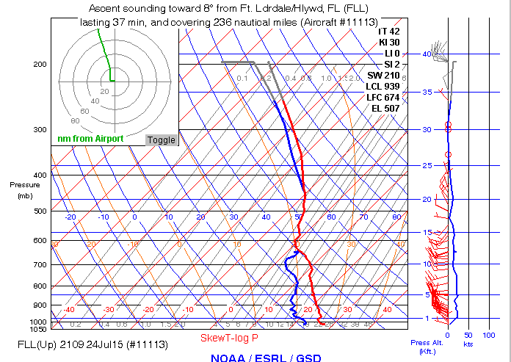
Icing Quiz
Where is the
greatest icing
potential?
No icing
above 14k ft
above 22k ft
14-25 k ft

Slide 37
Icing Quiz
Where is the
greatest icing
potential?
No icing
above 14k ft
above 22k ft
14-25 k ft

Slide 38
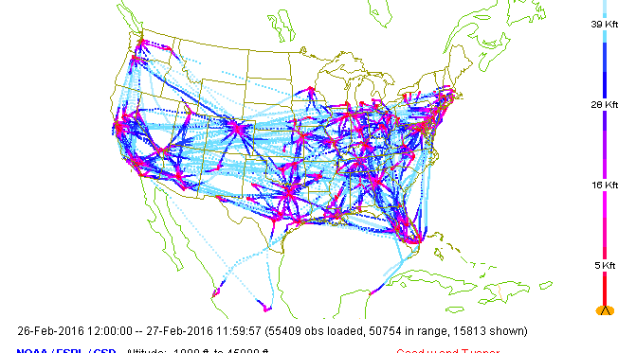
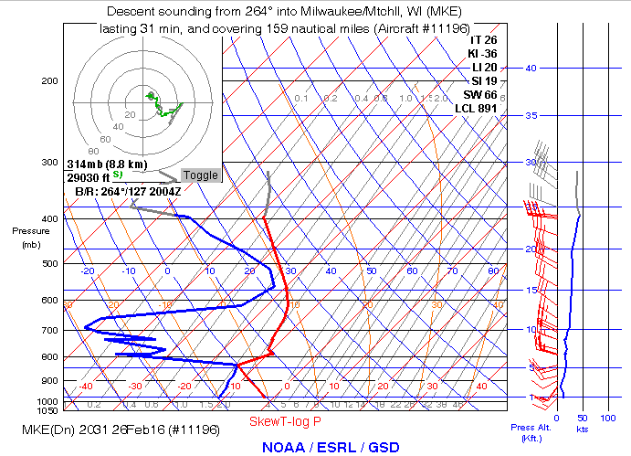
Coming This Fall
Soundings from commercial aircraft with water vapor sensors!
24 hours of water vapor soundings
Aircraft sounding from Milwaukee last evening

Slide 39
Questions?
Richard Mamrosh
NWS Green Bay (920) 497-8771
Richard.mamrosh@noaa.gov

Slide 40
Extras

Slide 41
Definition: Lifting Condensation Level (LCL)
The lifting condensation level (LCL) is the height at which a parcel of air becomes saturated when it is lifted dry-adiabatically.

Slide 42
Definition: Convective Condensation Level (CCL)
The convective condensation level (CCL) is the height to which a parcel of air, if heated sufficiently from below, will rise adiabatically until it is just saturated. Usually, it is the height of the base of cumuliform clouds produced by thermal convection caused solely by surface heating.

Slide 43
Definition: Convective Temperature
The convective temperature (T_{c}) is the surface temperature that must be reached to start the formation of convective clouds caused by solar heating of the near-surface layer.

